Slide 1
Fairness in the Gig Economy
Janet Taylor and Evan Kessler

Slide 2

Why care about review fairness?
“4.6 is the important number when it comes to driver ratings. If a driver's rating is 4.6 or lower then Uber is going to start considering kicking that driver off the system.”
Source: Business Insider
Doesn’t take much to have a major impact
The last 500 reviews are taken into account when calculating a driver’s overall rating
They can become ineligible for bonuses or receive fewer offers to drive
Imagine losing a major source of income to something out of your control!

Slide 3
Our Objectives
01
Create criteria
Define a mechanism for determining whether a review is fair or unfair
04
Validate models
02
Ensure that models are generous, but not to the point where justified reviews are ignored
Analyze data
Look for trends that amplify likelihood of unfairness
05
Exploration
03
Explore ways this could be integrated into existing systems
Model the data
Create models that can correctly help narrow down unfair reviews

Slide 4
What makes a review (likely) unfair?
Using this criteria, we labeled 650 Uber reviews as fair or unfair.
Mentioning cost
Drivers have no control over how much riders are charged
Mentioning wait times
Drivers cannot control how long it took for a rider request to be accepted
Complaining about personal traits
Drivers cannot control accents or other traits and have beliefs that should be respected
Accidental low ratings
112 out of the 650 labeled (about 17%) were unfair!
Review body and text is a glowing review of the driver, but a potential misclick left a low rating

Slide 5
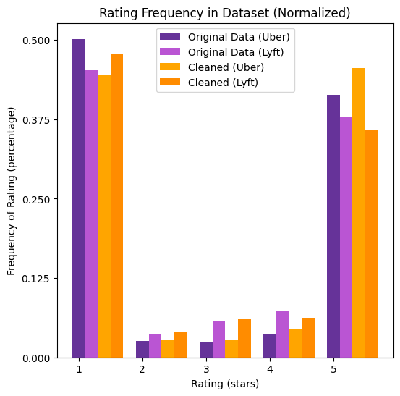
Data Collection and Cleaning
15,455 data points gathered from Lyft and Uber’s Trustpilot pages using Octoparse
Filtered down to 6,475 data points - Only reviews that mention drivers - Excluding reviews with invalid data for key predictors
Units of Analysis
Rating: 1☆ to 5☆
Review Body
Review Title
Total # of Reviews Left By User
Invited Review
Company
Date of Ride Experience
Observe - bimodal at 5☆ and 1☆! (Why?)

Slide 6
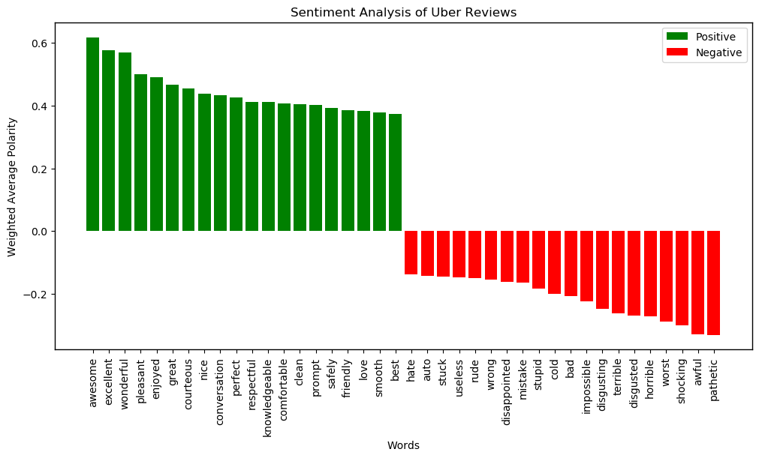
Results of Sentiment Analysis

Slide 7
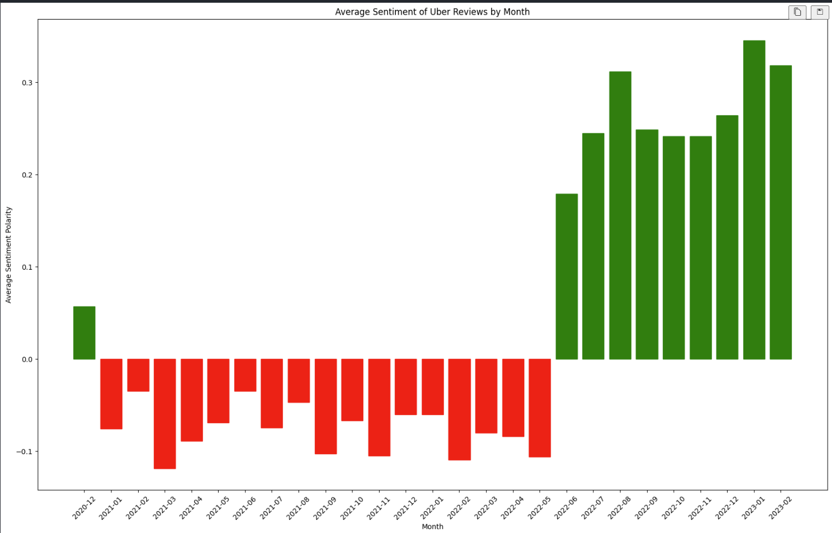
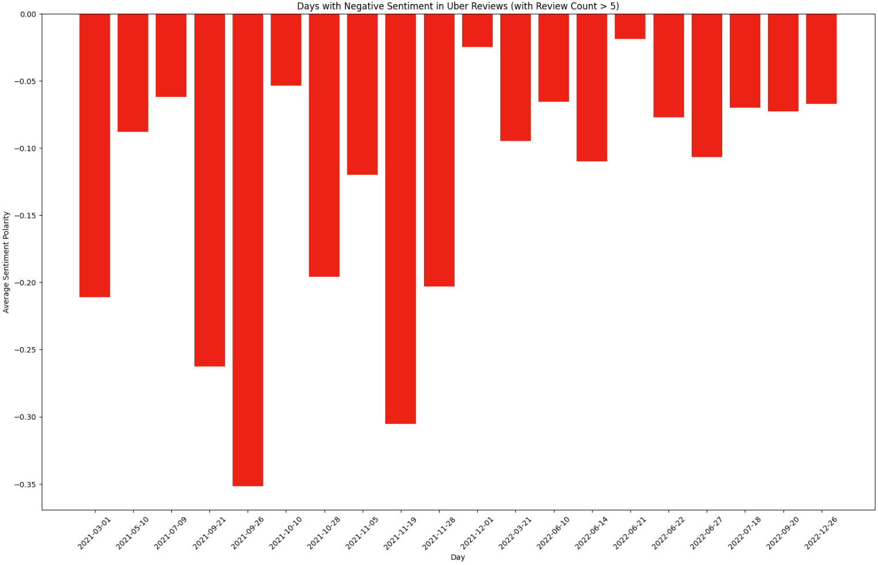
Time Valued Sentiment Analysis
Month by month & specific days
Notice periods of abnormal sentiment
What do these periods have in common?

Slide 8
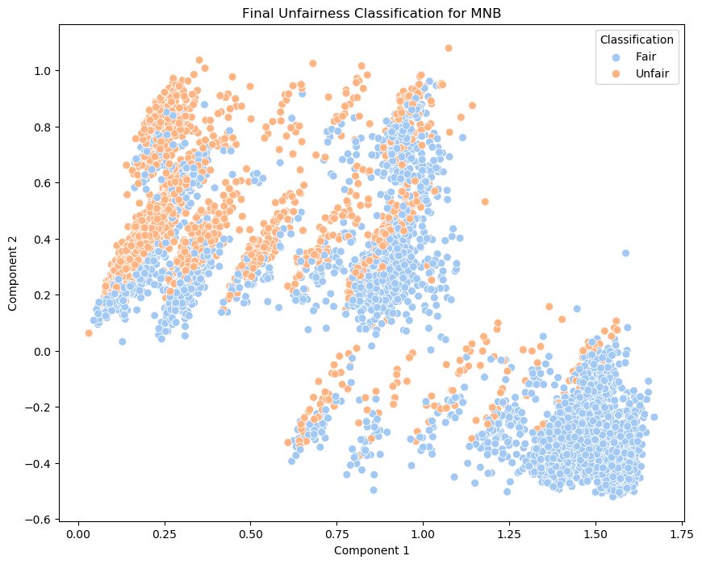
Multinomial Naïve Bayes Classifier
Why?
Inputs
Natural at text classification
Simple to understand
Most precise
Poor recall
Review Body (TF-IDF)
Review Title (TF-IDF)
88.62%
63.40%
69.51%
65.40%
Accuracy
Recall
Precision
F1

Slide 9
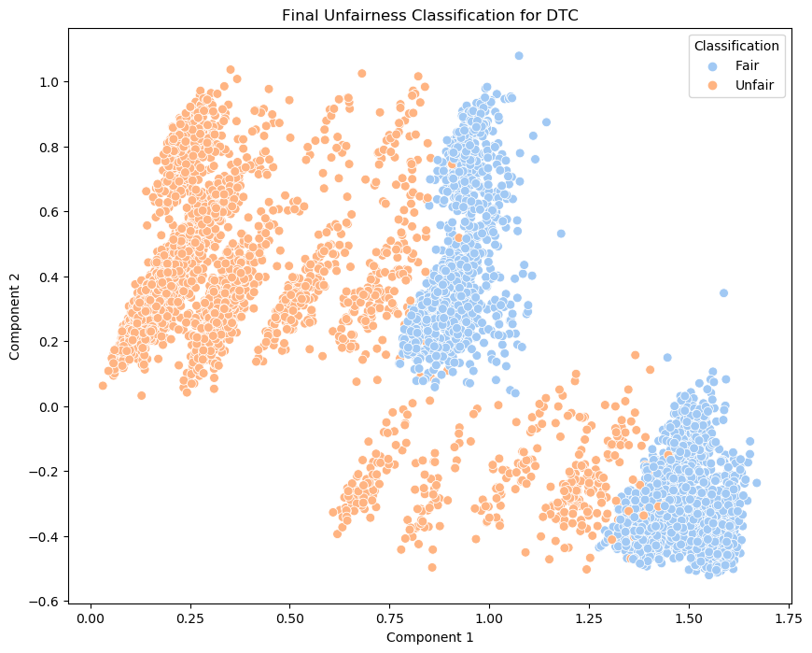
Decision Tree Classifier
Why?
Inputs
Natural at classification
Utilized Gini impurity w/few parent nodes
Best recall
Poor precision and tended to mislabel fair reviews
Rating
# Reviews Left
Invited Review
88.46%
100%
60.26%
75.10%
Accuracy
Recall
Precision
F1

Slide 10
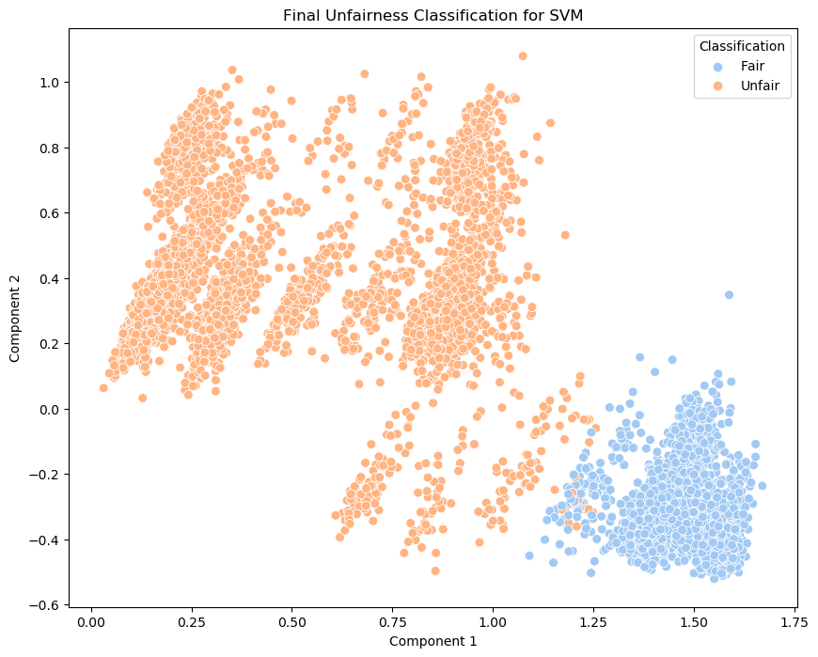
Support Vector Classifier
Why?
Inputs
Good at modeling non-typical functions
Used fourth degree polynomial kernel
Good all-around, but master of none
Weakest metric was precision
Rating
# Reviews Left
Invited Review
88.15%
82.96%
62.24%
70.80%
Accuracy
Recall
Precision
F1

Slide 11
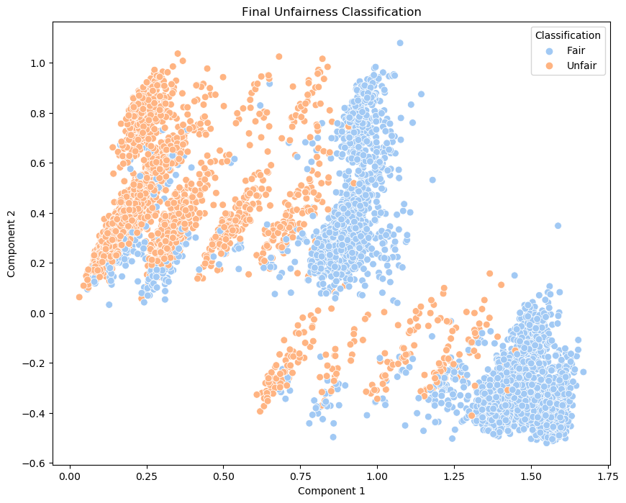
Voting Classifier
Why?
Inputs
MNB has great precision but very poor recall
DTC has great recall but poor precision
Best of both worlds – 70% DTC, 30% MNB
Final model!
Rating
# Reviews Left
Invited Review
TF-IDF data
90.00%
80.32%
68.41%
73.41%
Accuracy
Recall
Precision
F1

Slide 12
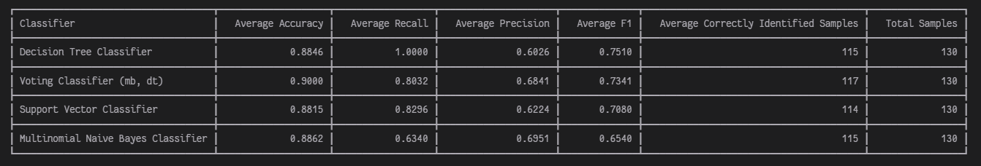
Interpretation + Validation
These metrics are the average of each metric from each round of a 5-fold cross validation
Similar accuracy – because the number of true negatives (unambiguously fair reviews) outweigh all other classes significantly
We focus on recall & precision - Make sure as few drivers are penalized unfairly as possible - But don’t unnecessarily ignore valid complaints

Slide 13
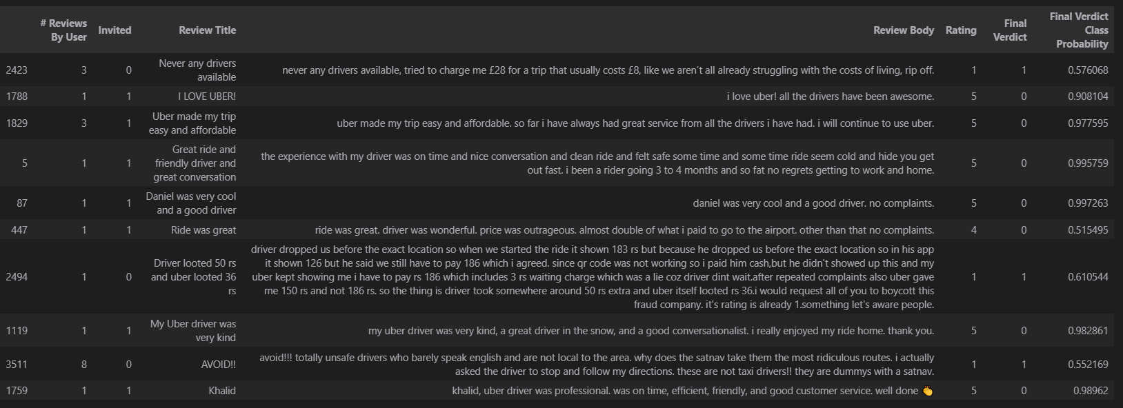
Identification of Ten Samples w/Voting Classifier
No model had ever seen any of these! Note #2423 and #3511
Notes:
#2423 – complaining about price and driver availability
#2494 – Complaining about cost
#3511 - Bigoted

Slide 14
However, we still believe very useful information can be extrapolated from our research!
Difficult to find public stores of Uber and Lyft driver reviews
Data Availability
Data was not cleaned perfectly – some things slipped through
Data Quality
Did not have much time to thoroughly label datasets – more data would significantly help
Labeling
Challenges
While many hours were spent attempting to find the best hyperparameters, some models were quite intensive to run
Processing Power
Asymmetry
Of the data present, Uber reviews had an extra predictor (Lyft did not prompt reviews) so the models are more tailored towards Uber
Unfairness
Of course, “unfairness” is still quite a social concept – it is subjective, and though we agreed the criteria we created summarized it, that may not be true.

Slide 15
Implementation Ideas
Ideas for Further Study
Use as a tool for Driver Service
…or use as a standalone tool!
Details on Review Reasoning
More Classes
Reviews flagged by the model could be used to prepare lists of reviews for driver services to review and decide on
The model could be incorporated into the existing algorithms for driver ratings, and flagged reviews could be weighted less (or not at all).
More classes could be added – perhaps representing a “borderline” review which has both fair and unfair aspects
Further expand the model to learn why a review was unfair – could be useful for areas of company improvement
(more on next slide!)

Slide 16
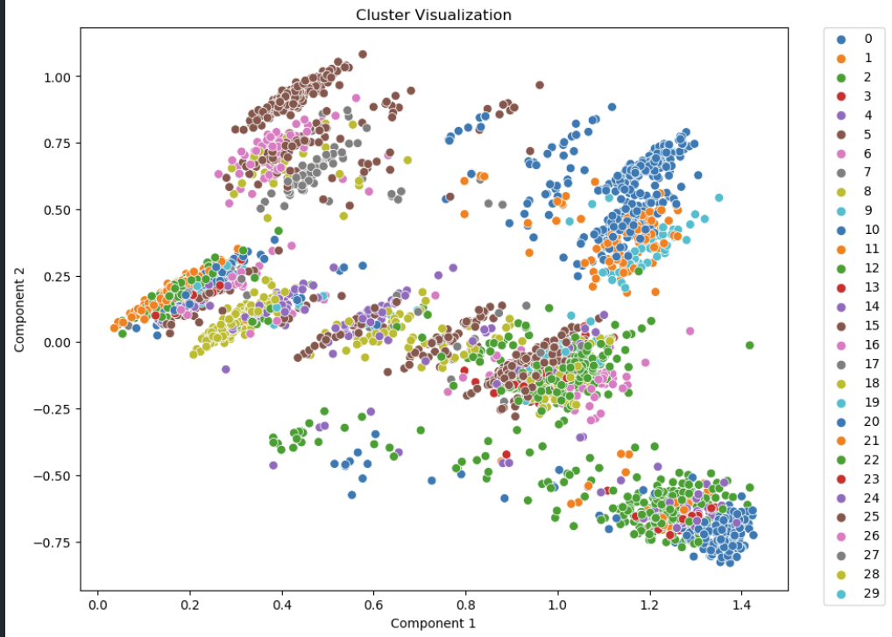
Experiment: Clustering
Attempted Bisected k-Means clustering with both k=10 and k=30 to poor results
Generally grouped unfair and fair reviews together in clusters
However, it was good at determining why a driver left a review! (ex. cluster 4 w/k=30 was primarily reviews left because of friendly drivers)

Slide 17
Thank you for listening!
Q&A Session

Slide 18
References
[1]
How Ratings Work - Driver App Basics. Uber. Retrieved April 25, 2023 from https://www.uber.com/ca/en/drive/basics/how-ratings-work/
[2]
James Cook. 2015. Leaked Charts Show How Uber. Business Insider. Retrieved April 25, 2022 from https://www.businessinsider.com/leaked-charts-show-how-ubers-driver-rating-system-works-2015-2
[3]
Marissa Miller. 2020. How bad Uber ratings affect drivers. Mic. Retrieved April 25, 2022 from https://www.mic.com/life/how-bad-uber-ratings-affect-drivers-careers-why-you-shouldnt-be-scared-to-report-bad-behavior-17865617

